Slide 1
Data Science Practices in Modern Banking: From Transactional Data to Customer Insights
Group 29
Xiaotong Jin
Bojing Hou
Jingzhe Gao
Taiyu ZhaoTaiyu Zhao
Data Science Mini-Project
Problem C

Slide 2
Catalogue
1. Data preparation
2. Data visualization
3. Transaction amount predict
4. User segmentation and recommendation algorithms

Slide 3
1. Data preparation
– Xiaotong Jin

Slide 4
Data preparation
Timestamp
Transaction Classification
Transaction Amount Accuracy
Missing Values

Slide 5
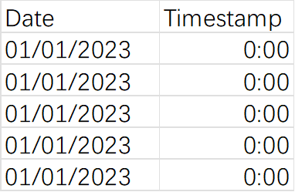
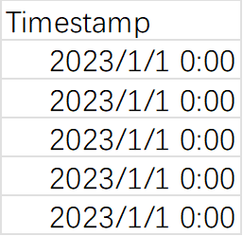
Timestamp Processing
Merge the columns: Date and Timestamp
Convert them into ‘datetime’ format

Slide 6
Transaction Classification
• Class 0: Personal Account or Unknown Account
• Class 1: Technology & Cultural Development
• Class 2: Fashion Trend
• Class 3: Lifestyle & Entertainment Crafts
• Class 4: Health & Living Services
• Class 5: Dining & Leisure
• Class 6: Comprehensive Retail Market
• Class 7: Active Lifestyle & Fitness
• Class 8: Financial Services & Accommodation
third-party accounts
nine categories

Slide 7
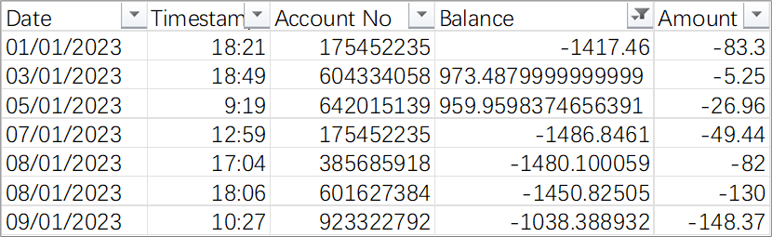
Transaction Amount Accuracy
Sorted all accounts in the dataset by trading time
Deduce the current balance from the previous balance and the current amount
Update it to the dataset

Slide 8
Missing Values
Time
Fill it with the average of the last and next transaction times of this transaction record
Try to fill these with data from unassigned accounts
Third Party Account
If Account number" is missing, it is filled with 0
If “Account name” is missing, it is filled according to its classification (personal or unknown).
Account\ Balance\ Amount
If the fill fails, we consider adding a new row

Slide 9
2. Data visualization
– Bojing Hou

Slide 10
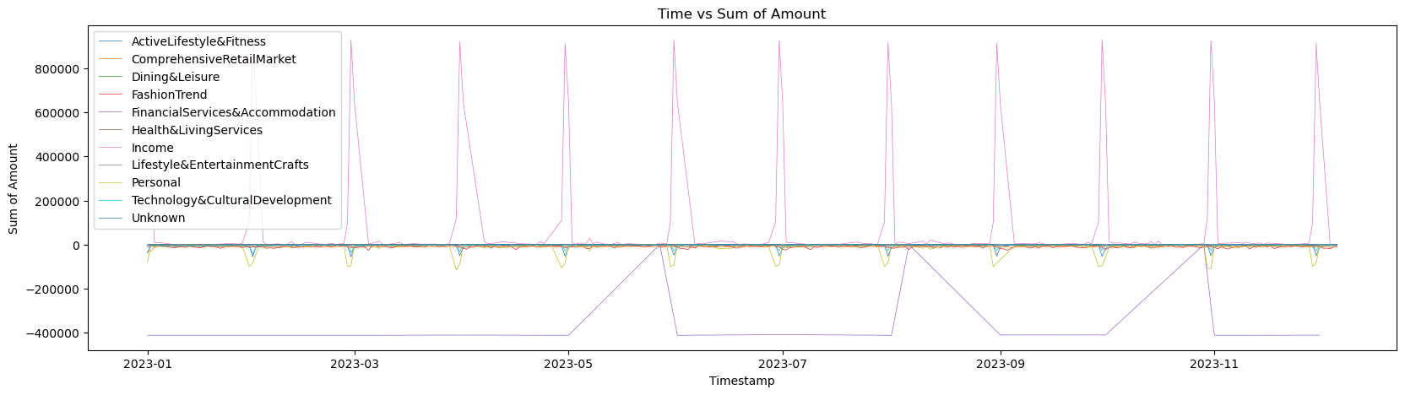
Daily Consumption Patterns
Observation:
Income peaks early in the month.
Notable dips in financial and lodging expenses during specific months.
Recommendation: Banks could offer overdraft services before payday.

Slide 11
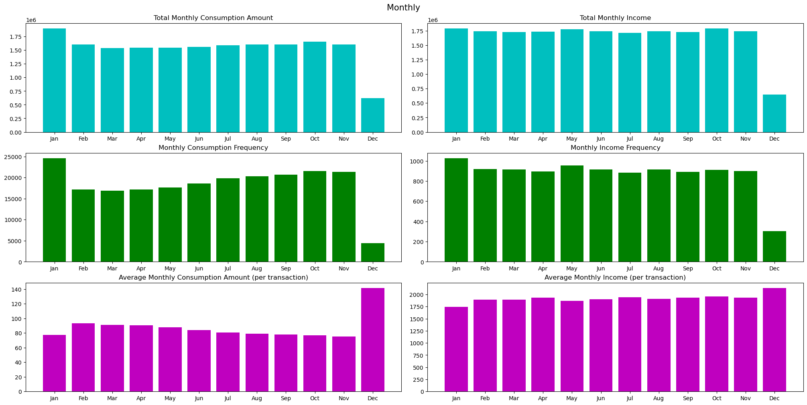
Monthly and Annual Trends
Observation:
Highest spending in January.
Highest transaction values in December.
Recommendation: Offer financial planning tools, such as budgeting advice.

Slide 12
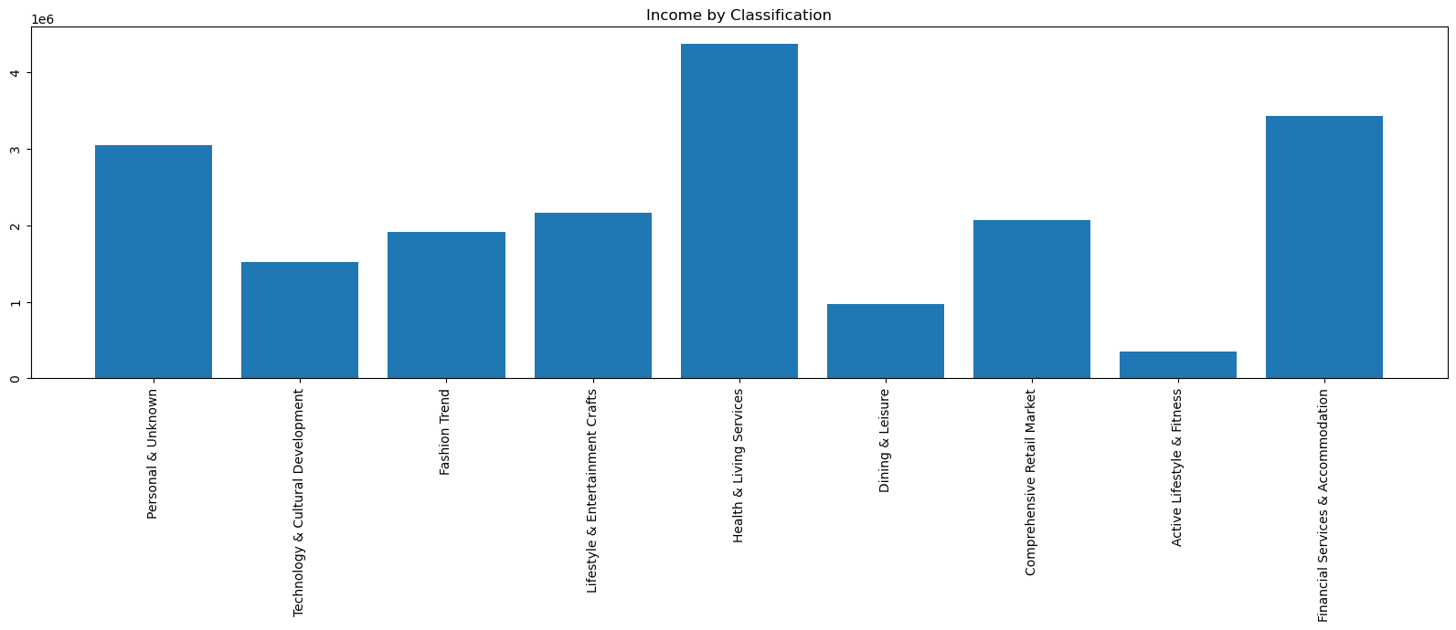
Category Analysis
Observation: High spending on health and living services.
Recommendation: Offer customized health insurance and emergency loans.

Slide 13
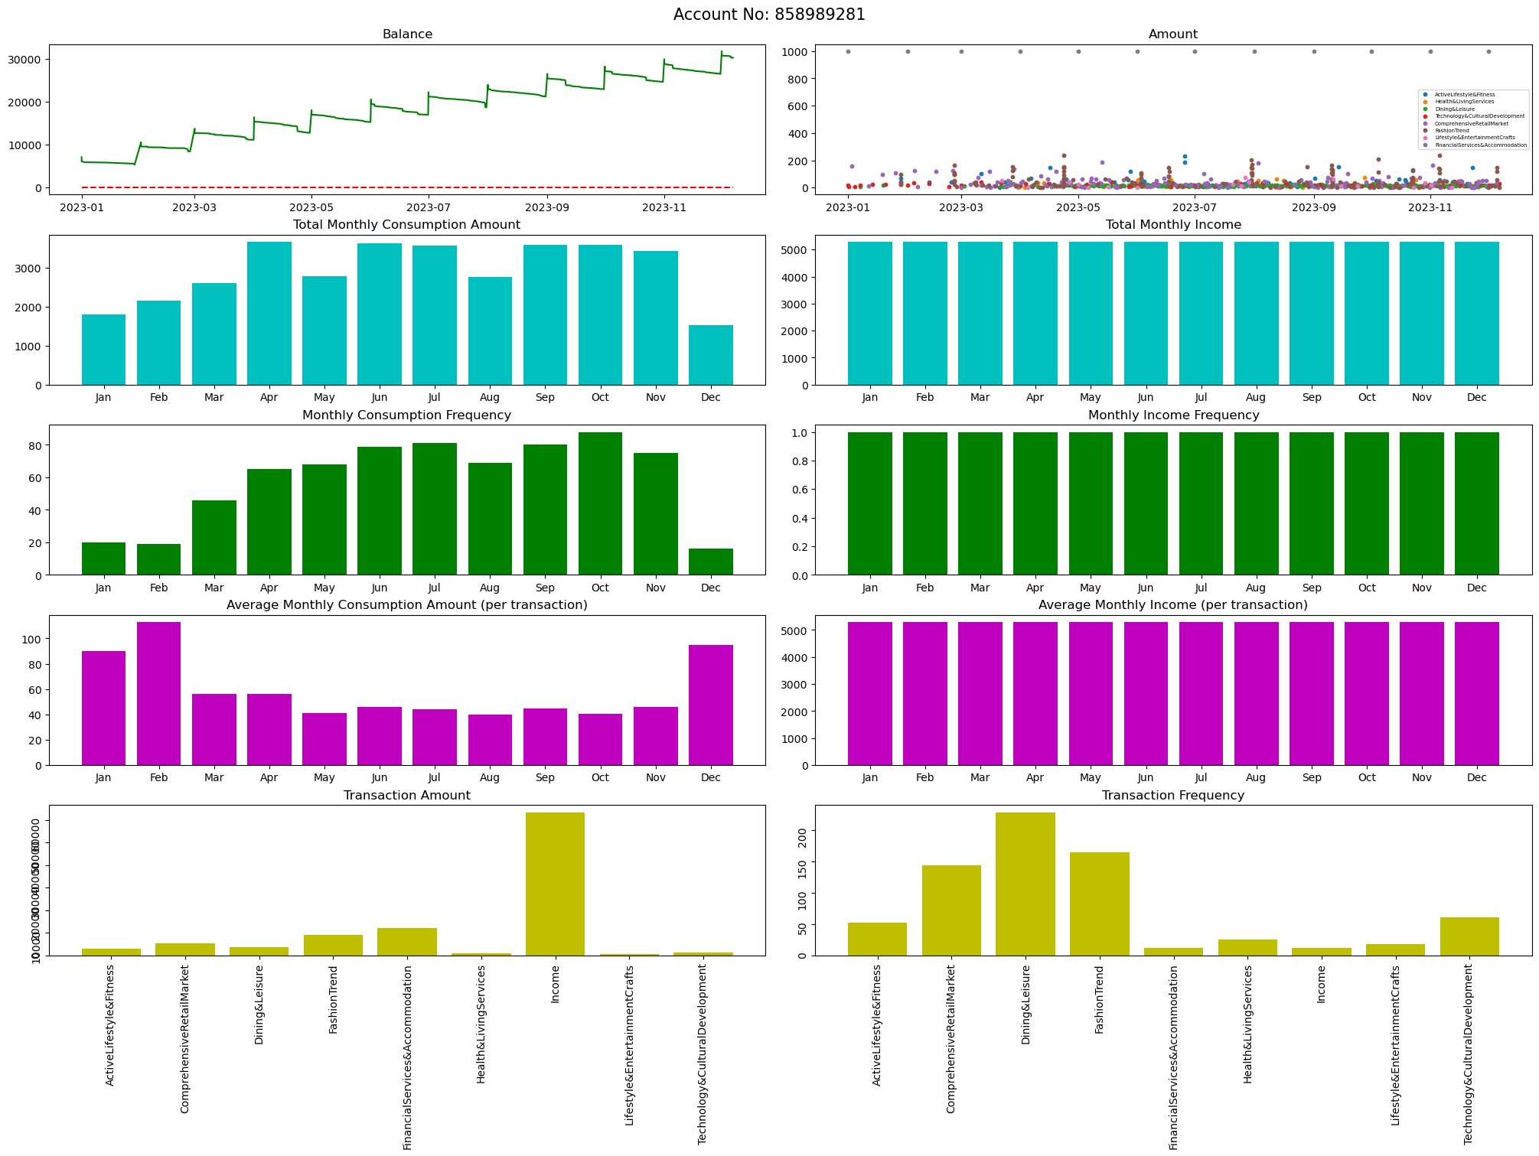
Case Study
Observation: High-volume user with stable high income and regular lifestyle.
Recommendation: Offer automated bill payments and budget tracking.

Slide 14
3. Transaction amount predict
– Jingzhe Gao

Slide 15
Add Data Columns
… | Classification Number | Classification Title | Month | Day | Day of the week
Classify transaction locations
Divide transaction time
Month
Day
Day of the week
Data normalisation with StandardScaler

Slide 16
Filter user and encode data
… | Day_of_week_1 | Day_of_week_2 | Day_of_week_3 | …
 | True | False | False
 | False | True | False
 | False | False | True
Selection the user with the most transaction records for analytical predicting
Use One-Hot to encode data
Most columns in the first dataset should be coded with onehot
A few columns in the second dataset should be coded with onehot to get better results

Slide 17
Train models to predict transaction amounts
Original data
Preprocessed data
SVR
Decision Tree
Random Forest
Linear
Regression
Neural
Network
Results

Slide 18
4. User segmentation and recommendation algorithms
– Taiyu Zhao

Slide 19
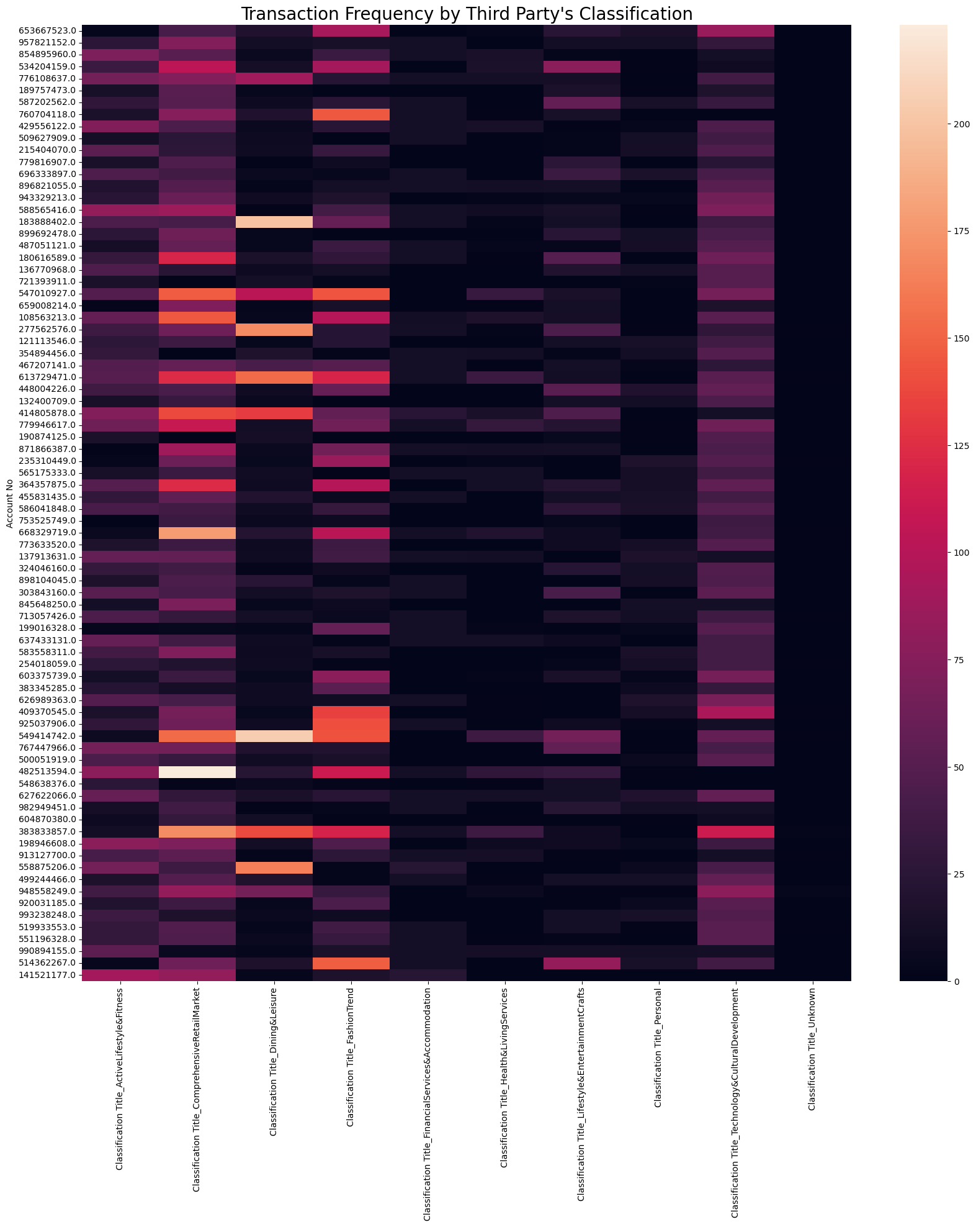
The x-axis is the merchant category.
The y-axis represent user accounts.
This heat map reflects how often customers spend money under each category. High consumption frequency reflects the users favor.
The brighter the color, the higher the frequency.
In the future
Different methods and criteria of grouping.
Overlap results under different scenarios.
Intersection: more precise.
Concatenation: more extensive.

Slide 20
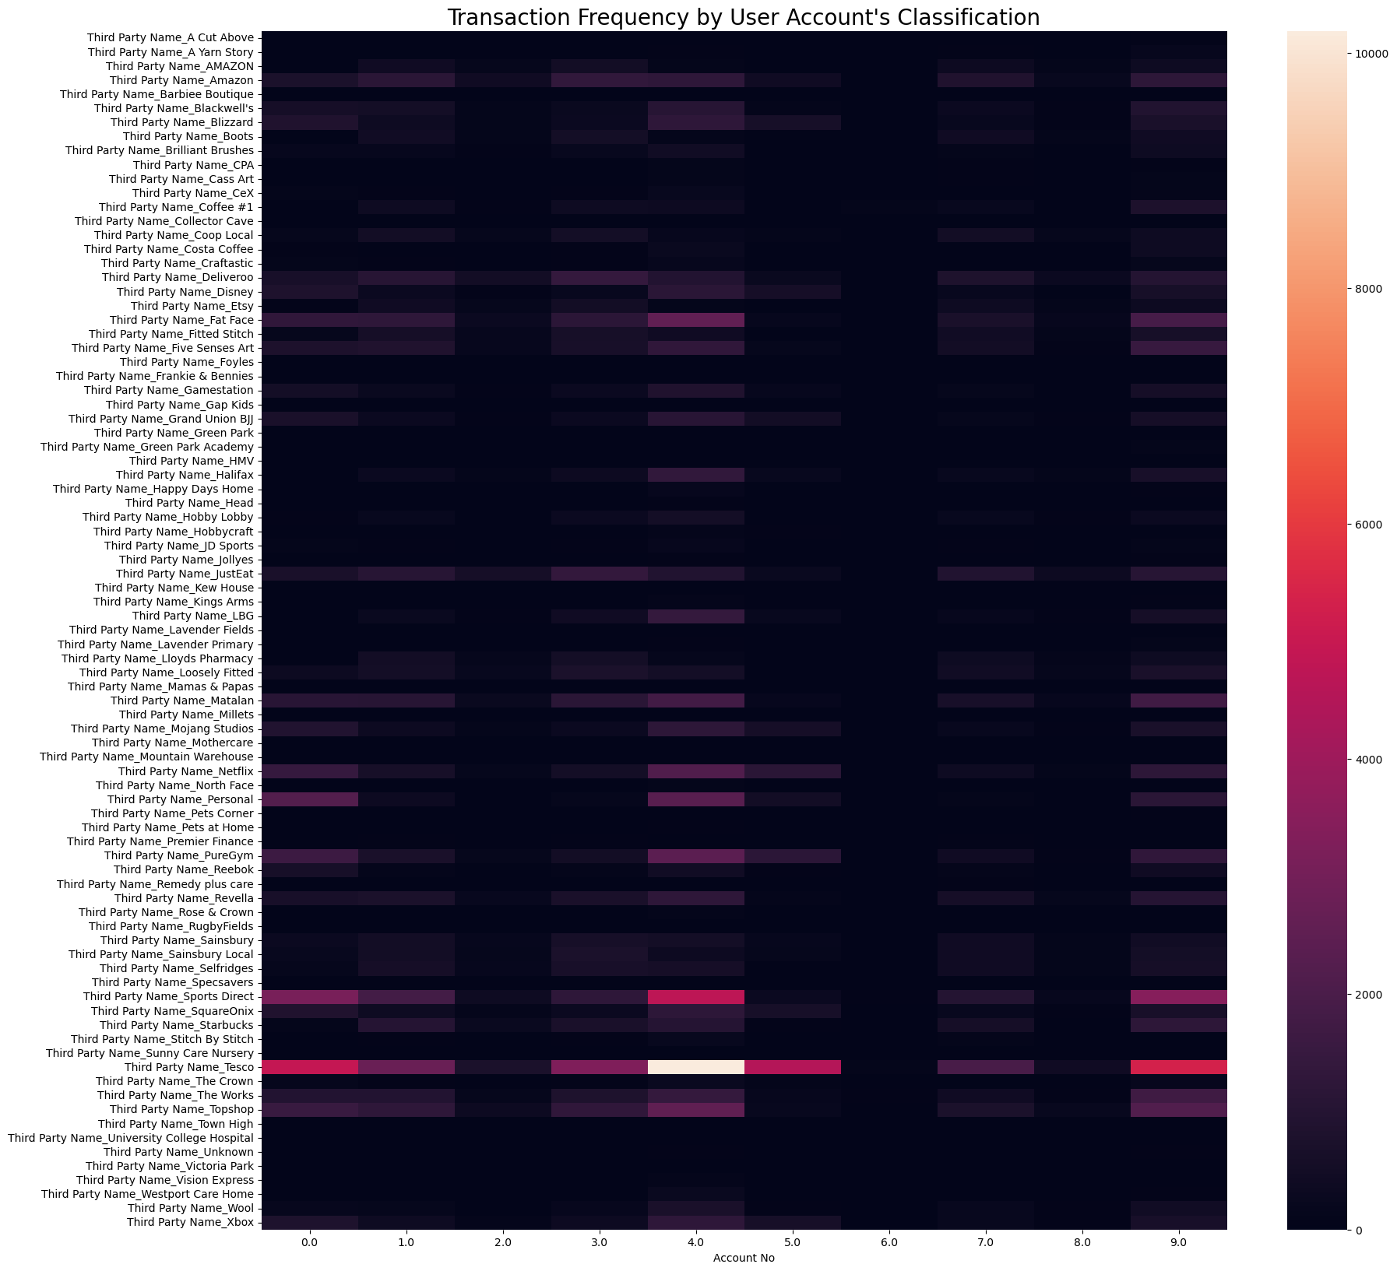
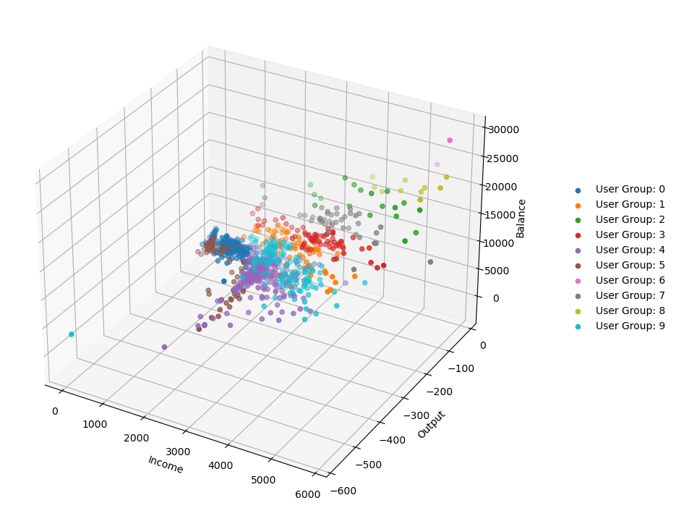
The x-axis is the customer category.
The y-axis represent third-party accounts.
This heat map reflects how often each customer group spend money in different stores. High consumption frequency reflects the corresponding potential user group.
The brighter the color, the higher the frequency.
Customer accounts were clustered into different groups based on data such as income, expenses, and balance.
In the future
Different methods and criteria of grouping.
Overlap results under different scenarios.
Intersection: more precise.
Concatenation: more extensive.

Slide 21
Thank You!
Group 29
Xiaotong Jin Bojing Hou
Jingzhe Gao Taiyu Zhao

